Slide 1

Project # 4 Data Model Implementation
Walmart Sales Predictions
Ana Brissa Miranda
Santiago Ayala
Ana Sofia Garrido

Slide 2


Slide 3

Overview:
Walmart Sales
Data obtained from
https://www.kaggle.com/code/aslanahmedov/walmart-sales-forecasting/input
Data contains sales from 2010 to 2012
The project aims to predict sales using Lineal Regression and Random Regression models.
We used 4 data sets and merged them:
Features
Test
Stores
Train

Slide 4
Background
Walmart has provided a data combining of 45 stores including store information and monthly sales.
The data is provided on weekly basis.
Walmart tries to find the impact of holidays on the sales of store.
For which it has included four holidays’ weeks into the dataset which are Christmas, Thanksgiving, Super bowl, Labor Day.

Slide 5
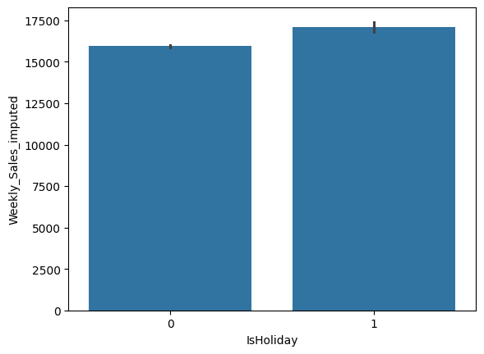
Data Clean up:
Spark Session was used due to the big data.
Using code and seaborn lineal plot heatmap, determine the relation and correlation between the variables.

Slide 6
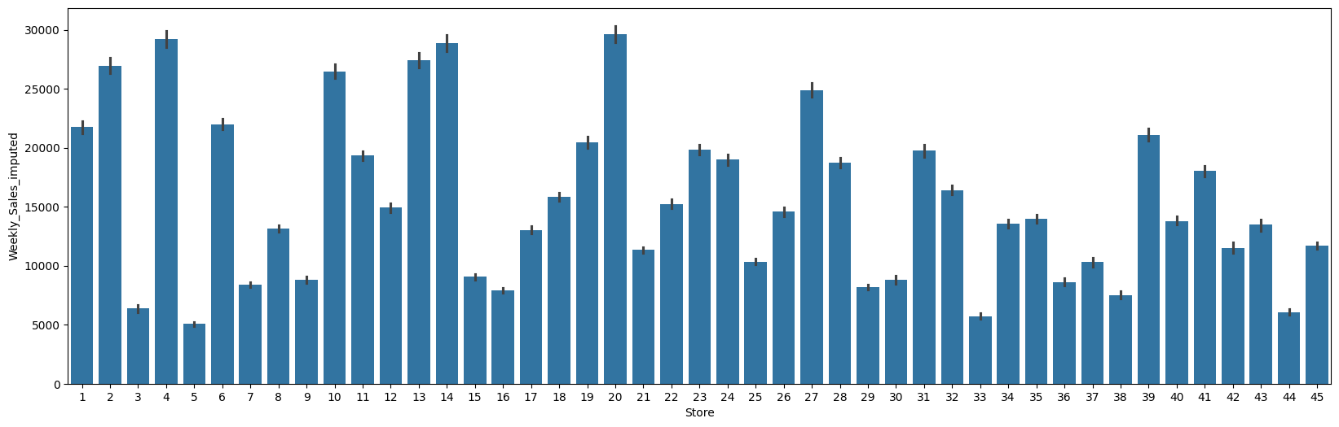
Data Clean up:
Relation of Stores vs Weekly Sales
The data has no too much missing values. All columns was checked.

Slide 7
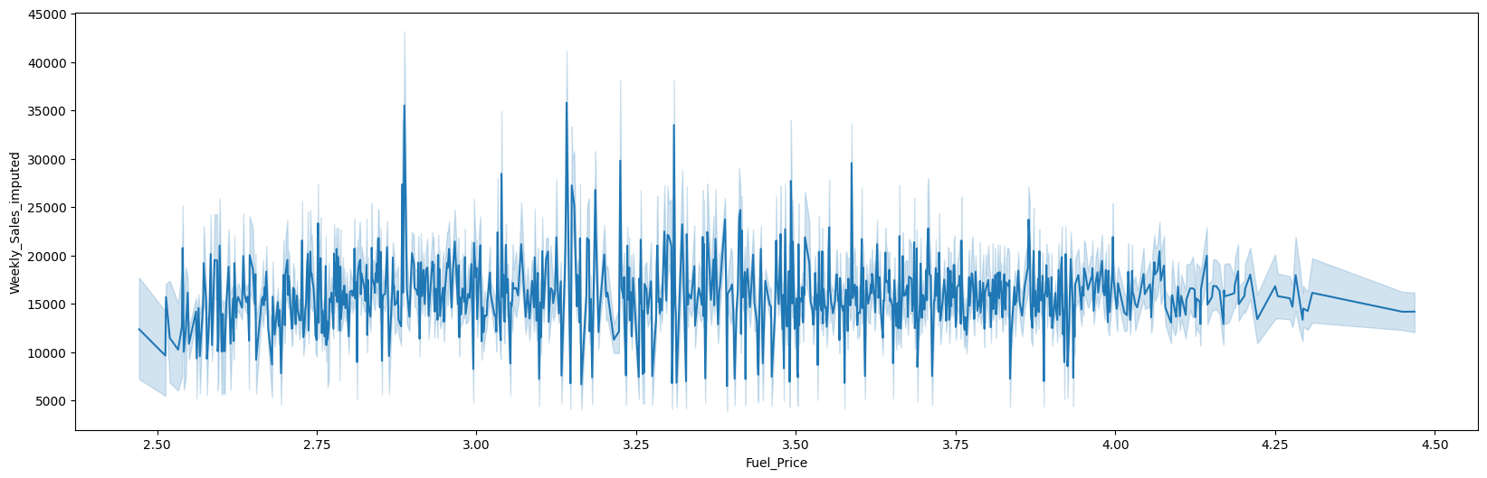
Data clean up:
Relation between WK Sales and Fuel Price
We noticed that Fuel Price and WK Sales doen’t have any correlation

Slide 8
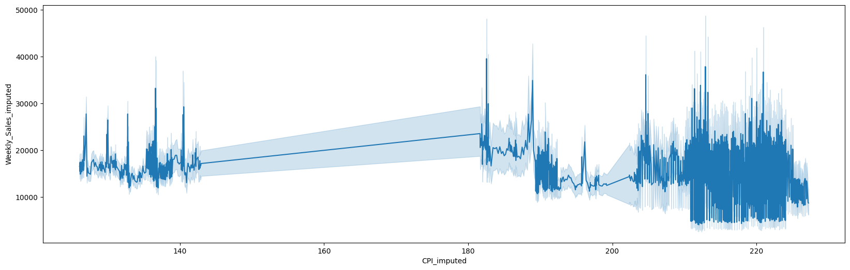
Data Clean up:
WK Sales vs CPI (Consumer Price Index)
There isn’t any relation between them.

Slide 9
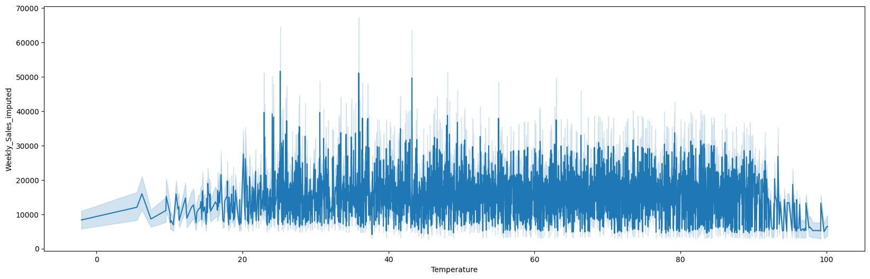
Data Clean up:
WK Sales vs Temperature
There isn’t any relation between them

Slide 10
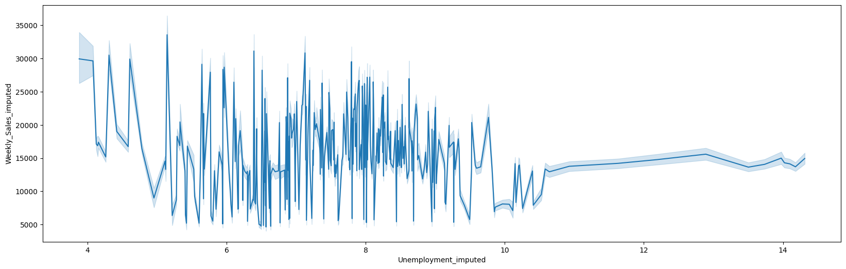
Data clean up:
WK Sales vs Unemployment
There isn’t relation between them

Slide 11
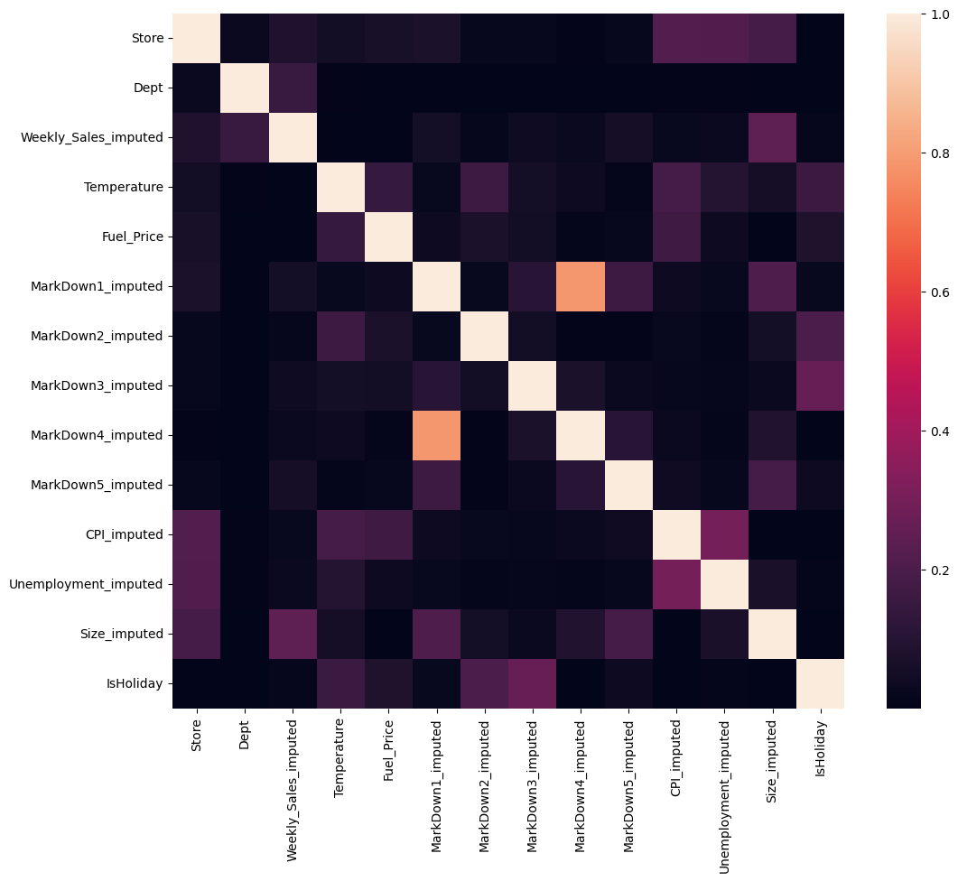
Correlation with store and Isholiday correlation between WK Sales and all the columns except Store, Dept, Type and Size are insignificant

Slide 12
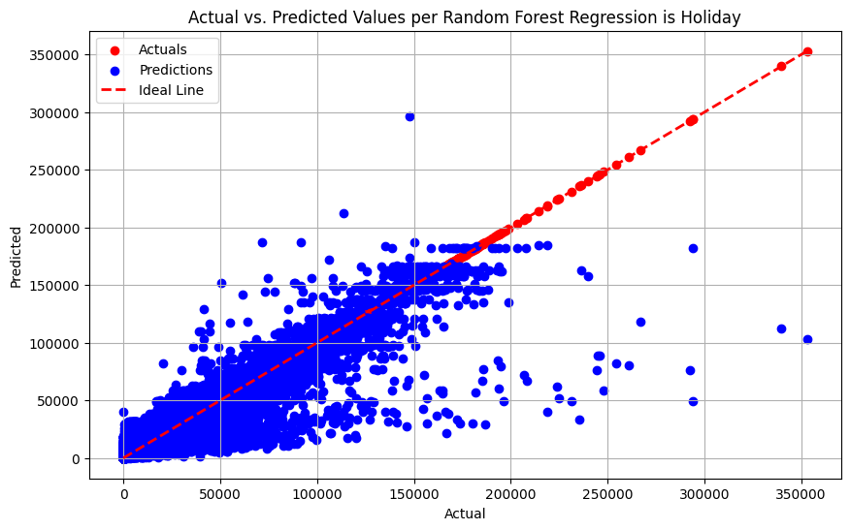
Random Forest Regressor model's performance is not perfect, but it's reasonable.

Slide 13
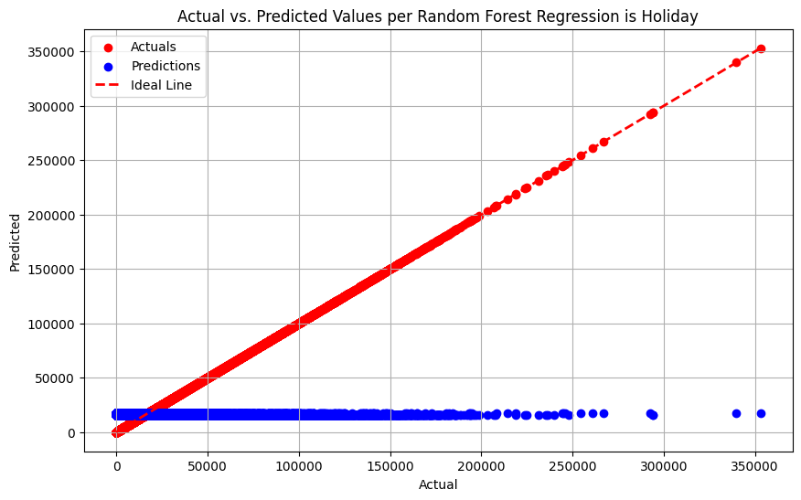
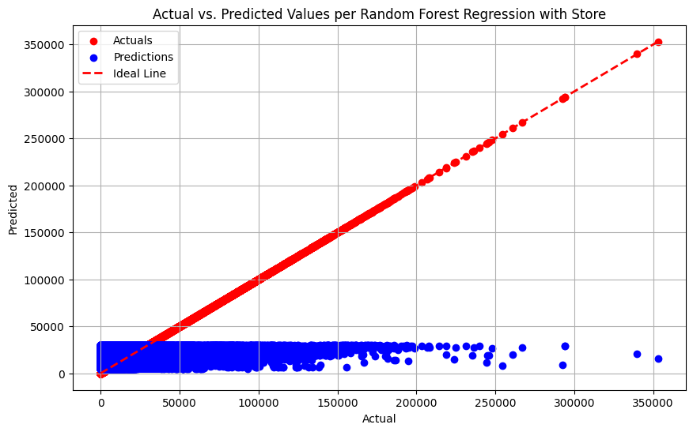
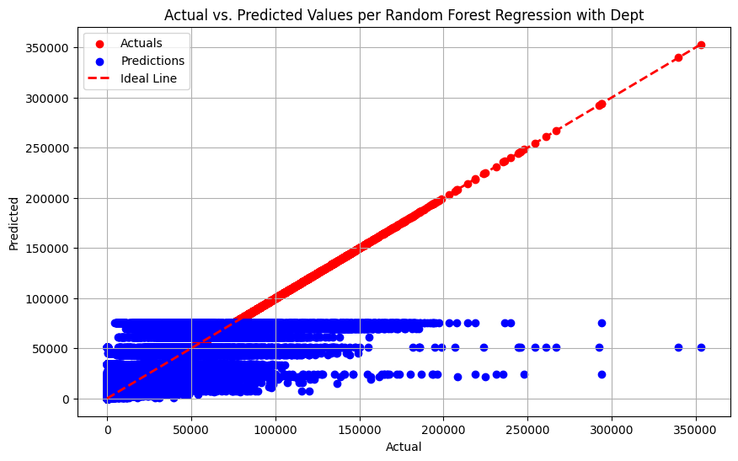
Improve the linear regression

Slide 14
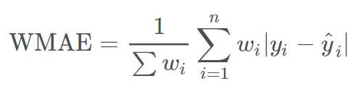
Our metric for this project is weighted mean absolute error (WMAE):
Weighted Mean Absolute Error (WMAE): 3008.541619381292

Slide 15
Tableau Results
https://public.tableau.com/app/profile/santiago.ayala.lomelin/viz/WalmartProyecto4/Dashboard1?publish=yes

Slide 16
Conclusions
While no single model achieved perfect performance, the Random Forest Regressor with hyperparameter tuning and feature selection demonstrated reasonable predictive power for weekly sales prediction. Further improvements could be explored by fine-tuning model parameters, trying different feature engineering techniques, and incorporating additional relevant data if available.

